Slide 1
Data Mining DS-303
Muhammad Arham
Lecturer
The University of Faisalabad

Slide 2
Content
Web Mining Techniques

Slide 3
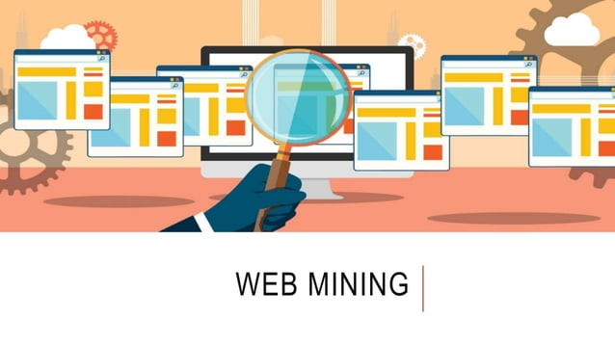

Slide 4
What is Web Mining?
Mining means extracting something useful or valuable from a baser substance, such as mining gold from the earth.
Web mining is the process of using data mining techniques and algorithm to extract information directly from the web.
It uses web document and services, web content, hyperlink and server logs.

Slide 5
Opportunities and Challenges
The amount of information on thw web is huge.
The coverage of web information is very wide and dievrse.
All types exist on the Web.
Much of the web information is semi-structured due to the nested structure of HTML code.

Slide 6
Opportunities and Challenges
Much of the web information is linked.
Much of the web information is redundant.
The web is noisy a mixture of many kinds of information.
The web is dynamic.

Slide 7
Data mining VS. Web mining
Traditional data mining
data is structured and relational
well-defined tables, columns, rows, keys, and constraints.
Web data minig
semi-structured and unstructured
readily available data
rich in feature and patterns

Slide 8
Classification of Web mining Techniques

Slide 9
Web Structure mining

Slide 10
Web Content Mining

Slide 11
Web content mining

Slide 12
Document Classification

Slide 13
Document Clustering

Slide 14
Association

Slide 15
Web usage mining

Slide 16
Web usage mining

Slide 17
Web-usage mining

Slide 18
Web-usage mining

Slide 19
Web-usage mining

Slide 20
Web-usage mining

Slide 21
Web-usage mining

Slide 22
Web usage Data

Slide 23
Transfer / Access Log

Slide 24
Agent Log

Slide 25
Referre Log

Slide 26
Error Log

Slide 27
Web usage mining model

Slide 28
Refernces
https://www.slideshare.net/slideshow/web-mining-80147714/80147714
https://www.slideshare.net/slideshow/web-mining-252374600/252374600

Slide 29
Advice
Kindly read the book before and after the lecture, if some terms/ words are not covered in the lecture, if appear in exam it might not appear strange or out of course.

